Slide 1



MAPPING
TEAM 2
Sara DuPont & Taylor Graves
CSCI 110
Web-Based Services Project
4/18/08
vs.

Slide 2
Web-based Mapping Services
greatly impacted travel all over the world
navigation much more tangible and accurate by offering easily accessible updated features
old, paper, out-dated maps that were kept in the glove box

Slide 3
What are some features you would expect from a web-based mapping service?

Slide 4
Expected Features
routes and directions
searching options
picture maps
overlay paths
icons, symbols
time and distance of travel
custom controls
variety of viewing options

Slide 5
Quick Facts
US visits to maps websites is up 10% year on year
MapQuest is the leader, receiving more than half of all US visits to Maps websites
MapQuest had five times (429%) more US visits than Google Maps
  Last record kept showed that gap down to 126%.
Google Maps is the #2 Maps website in amount of visits
  attracted 22% of visits to Maps websites.
Traffic to MapQuest has remained unchanged year on year
  down 20% in the past 6 months.
Google Maps traffic is up 135% year on year
  up 7% in the past 6 months.

Slide 6
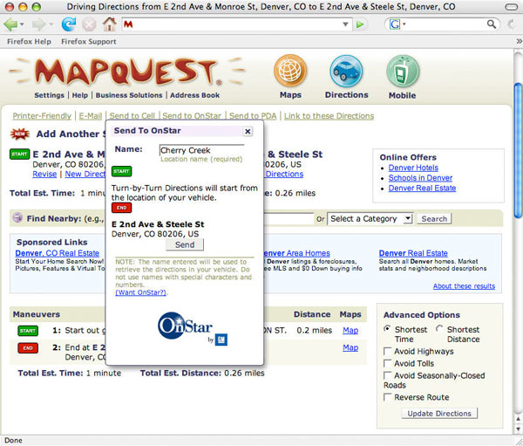
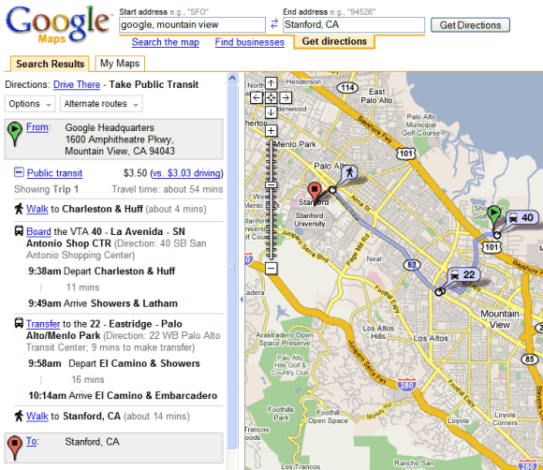
MapQuest vs. Google Maps

Slide 7
Shared Features
default address setting
link for help
business information
Map features:
  aerial views
  traffic button
  highlighted path
  zoom option
  estimated travel time and distance

Slide 8
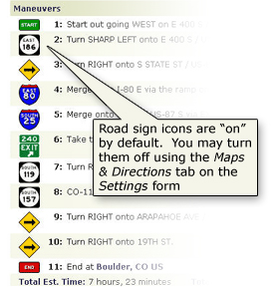
MapQuest
web-based mapping service
a subsidiary of American Online, Inc. (AOL)
in operation for 30 years
http://www.mapquest.com
easy to access and navigate
large, colorful icons
user friendly

Slide 9
Newest MapQuest Version
MapQuest's Advantage (TM) API
  uses Action Script 3.0 and Adobe Flex (TM) or Adobe Flash software
  de-clutter
  improve the quality of the shapes, lines and pictures on website and maps

Slide 10
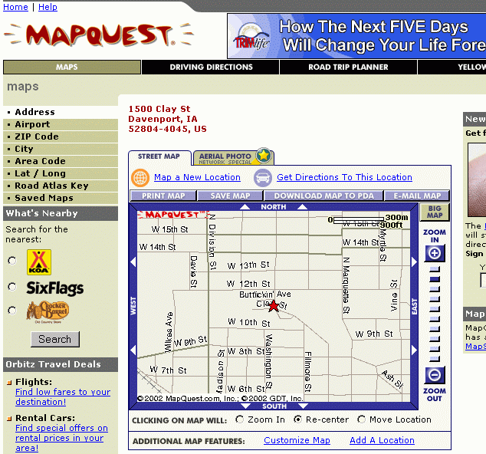
MapQuest
search:
  location
  particular address
  road maps
  directions
  gas stations and fuel prices in a particular area
directions:
  choose to avoid tolls and/or highways
  may choose shortest distance or shortest travel time
  estimated travel time and distance included

Slide 11
MapQuest
built-in routing capability and geocoding capability
MapQuest toolbar can be added to browser for added easy access
speed limits across the country available
provides more desirable route than Google Maps

Slide 12


MapQuest Mobile
easily send search results from the computer to mobile device
access with full-color, movable maps and text directions
mobile options include Global Positioning System (GPS) feature called MapQuest Navigator 5.0
  works along with AOL CityGuide
local listings and ratings of restaurants and nightlife
lowest gas prices in your area of location

Slide 13
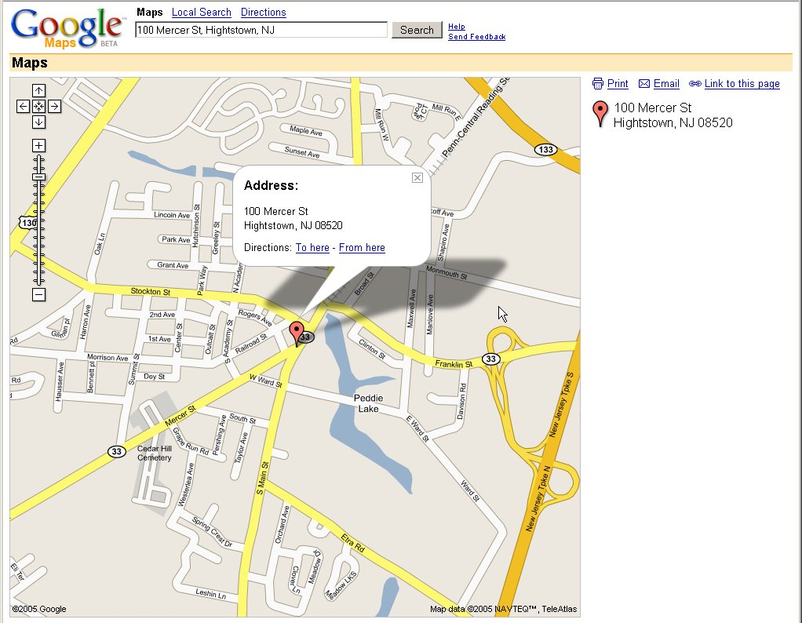
Google Maps
powered by Google, Inc.
latest mapping technologies blended
  i.e. Google Earth and Google search engine
http://maps.google.com
user friendly
simple application
clean layout
has become the most popular mapping site

Slide 14

Google Maps Exclusive Features
keystroke/mouse zooming
dragging options
satellite imagery
largest developer base
topographic view
navigational tips
latitude and longitude coordinates
360 degree Street View with zoom

Slide 15
Google Maps Exclusive
My Maps customize your own map
  add images
  descriptions
  embedded videos
  highlight specific paths
  write notes
Uses all other Google products so has a great advantage over MapQuest in many aspects

Slide 16




Slide 17
What improvements or changes would you recommend for either of these mapping services?

Slide 18
Which mapping service do you think is most efficient for your needs?

Slide 19
Did you learn anything about either mapping service that you did not know?

Slide 20
Sources
Business Week. Software and Technology Services. MapQuest. 2008. http://www.investing.businessweek
Elgin, Ben. Google Tops the Charts. 2008. McGraw-Hill Companies Inc. http://www.businessweek.com
Hamilton, Anita. "Google Tricks". TIME Magazine. February 2005. Time Magazine, Inc.
http:// www.mapquest.com. MapQuest, Inc. 2008. America Online, Inc.
http://www.maps.google.com. 2008. Google, Inc.

Slide 21

MAPPING
Team 2
Sara DuPont & Taylor Graves
CSCI110
Web-based Services Project
4/18/08

